Slide 1
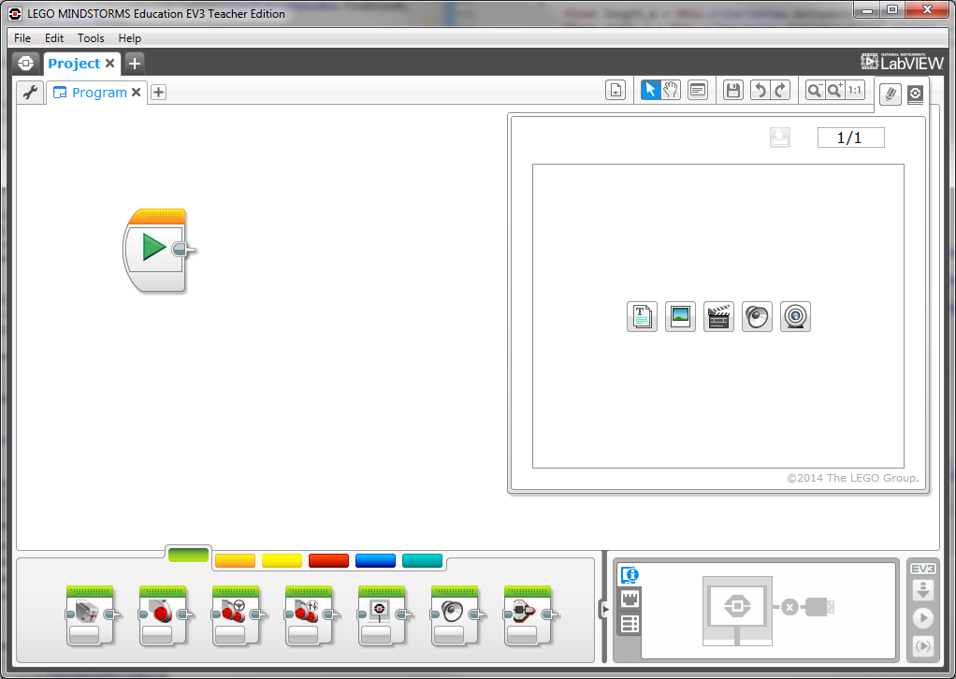

Slide 2
Change Project Name
Double Click
Change Program Name
Double Click

Slide 3
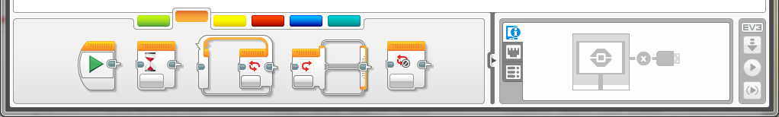
Green Does “stuff”
Move, Sounds, Lights
Steer
Orange “Thinks”
Wait
Loop
Switch

Slide 4
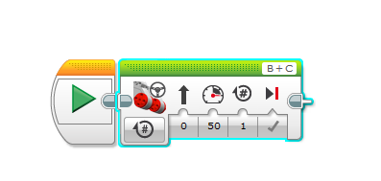
Units
How many units to rotate
Steer
Speed + Front/Back

Slide 5
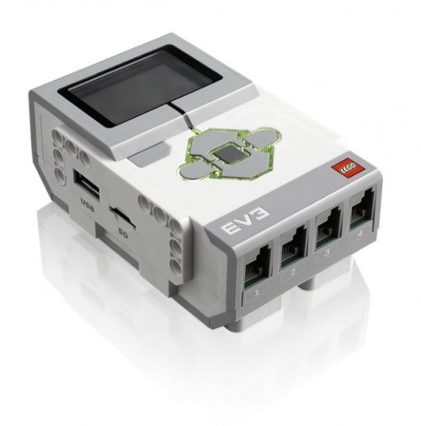
Building LEGO® EV3
USB Port for Connection to Computer
Motor Output Ports
LCD Display Screen
Navigation Buttons
Memory Expansion
Sensor Input Ports
Notes:
§ EV3 “brick”
· Have students compare these to human capabilities (brain)
· Controls motors, lights and LCD screen based on instructions and sensory input

Slide 6
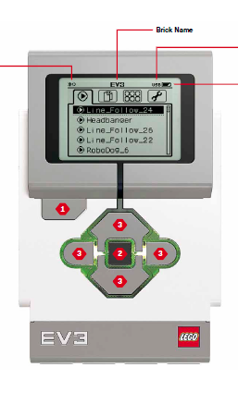
Your program will be here after you download
PANIC!!!

